Slide 1







BIG DATA ENGINEERING PROJECT
Presented by
Sandhya
Savya sree
Satyaveni
Narendra Jadhav
Arsalan
Furqan

Slide 2


CONTENTS
01
02
Big Data Solution Architecture
E-Commerce Sales Analysis (Hive)
03
04
Spark Architecture
Walmart Stocks Analysis(SparkSQL & PySpark)

Slide 3















BIG DATA SOLUTION ARCHITECTURE
Live applications
ETL PIPELINE
SOURCES
DATA INGESTION
ANALYSIS
VISUALIZATIONS

Slide 4
TECHNOLOGIES USED
HIVE
PYSPARK
Version: 2.6.0
HADOOP
Version: 3.3.2
Mode : Standalone
Version: 1.1.0

Slide 5


E-COMMERCE SALES ANALYSIS

Slide 6
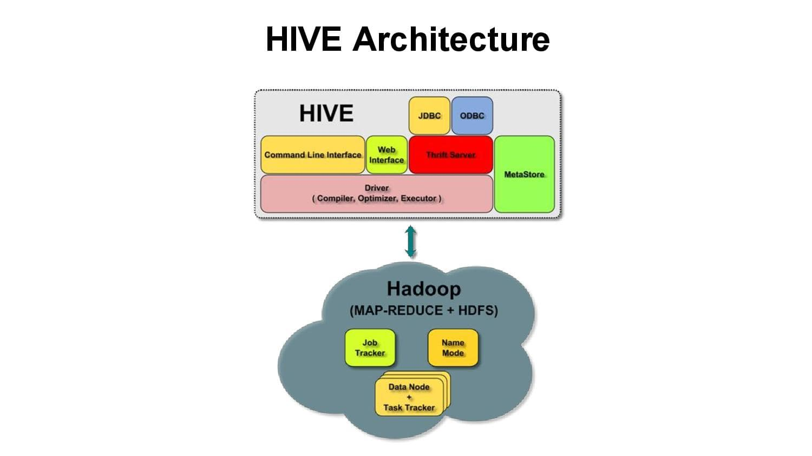

Slide 7
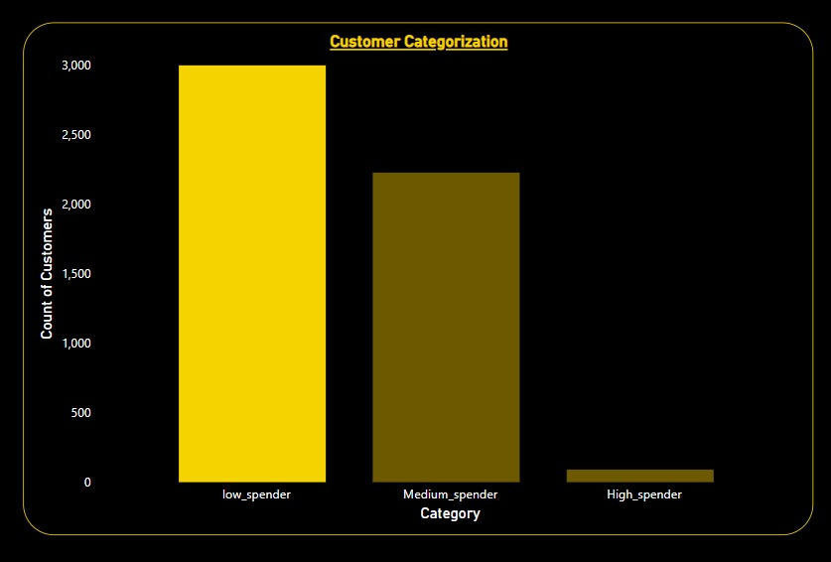
Customer categorization based on amount spent by customer
create external table PS1 (custoemr_id string, total_amnt double, spending_habits string)row format delimited fields terminated by ' ' location '/user/hive/warehouse/hiveProject/ps1/problem1.txt’;
insert overwrite table PS1 select customer_id, sum(payment) as total_spending,case when sum(payment) >= 2000 then ‘high spender' when 500>=sum(payment)<=1500 then ‘Medium Spender' else ‘low Spender' end as Spending_Habits from ecom_data group by customer_id;

Slide 8
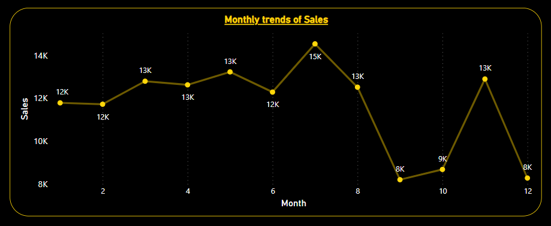
Monthly trends forecasting of Sales
create external table PS2(sales_month string, total_sales double)row format delimited fields terminated by ',' location '/user/hive/warehouse/hiveProject/ps2/problem2.txt’;
insert overwrite table PS2 select month(datetime) sales_month, sum(quantity) as total_sales from ecommerce_sales group by month(datetime) order by sales_month;

Slide 9
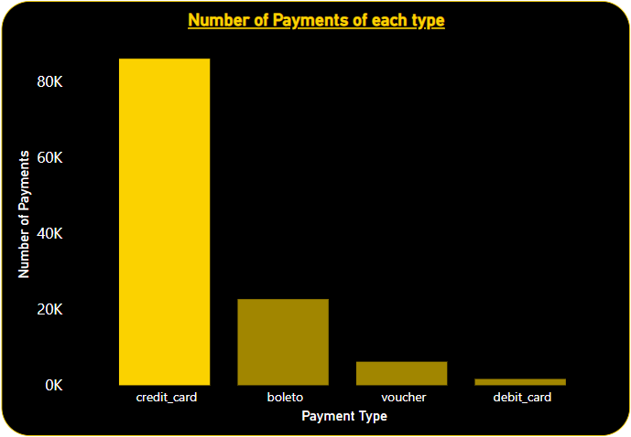
Most commonly used Payment methods
create external table PS5_1 (payment_type string, sales_count int)row format delimited fields terminated by ',' location '/user/hive/warehouse/hiveProject/ps5/problem5_1.txt’;
insert overwrite table PS5_1 select payment_type,count(*) as sales from ecommerce_sales group by payment_type order by sales desc;

Slide 10
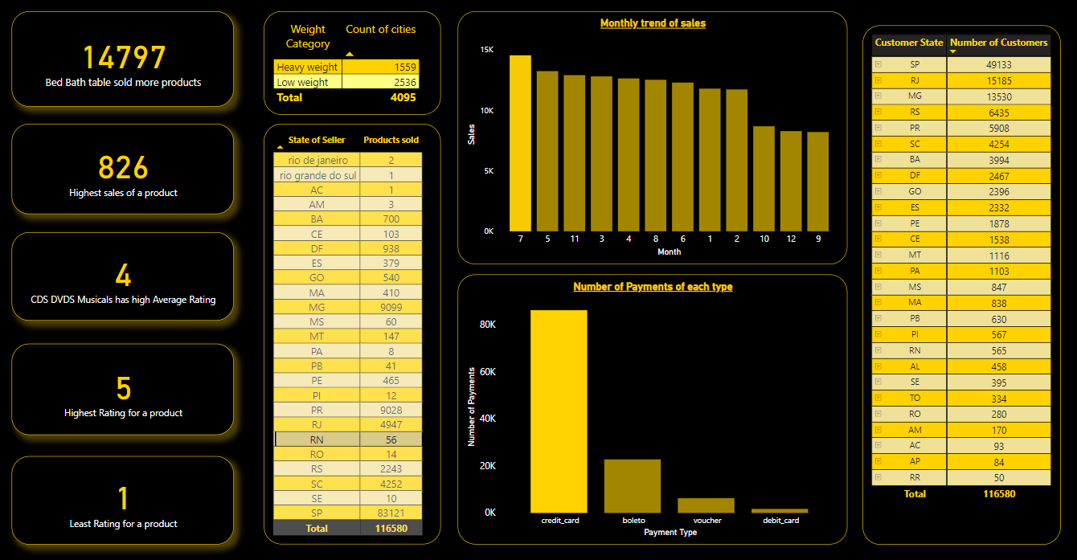

Slide 11
WALMART STOCKS DATA ANALYSIS

Slide 12
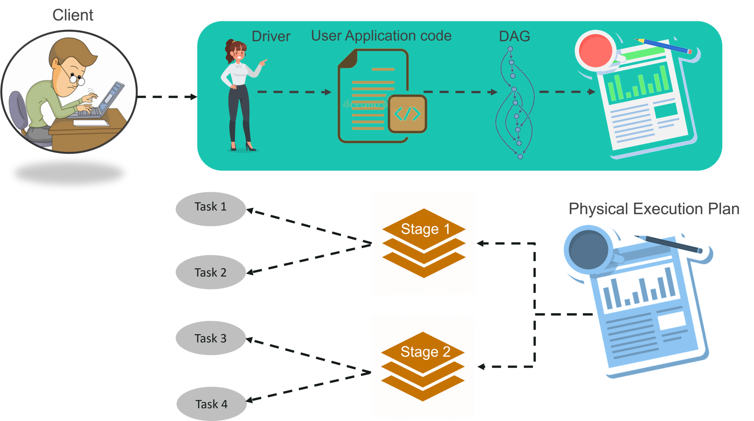
SPARK ARCHITECTURE

Slide 13
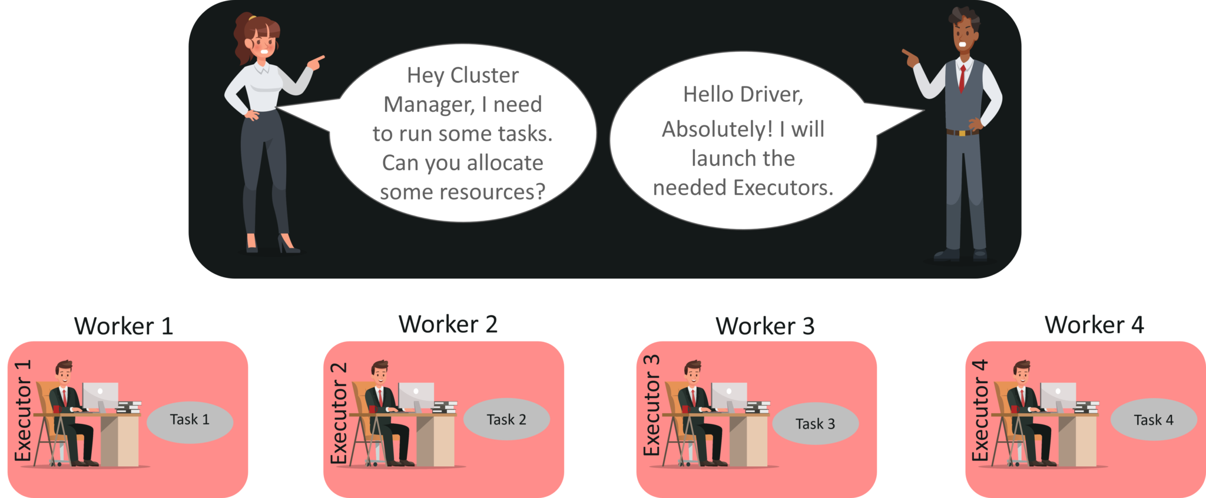
SPARK ARCHITECTURE

Slide 14
SPARK ARCHITECTURE

Slide 15
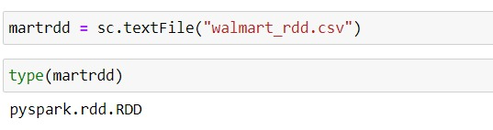
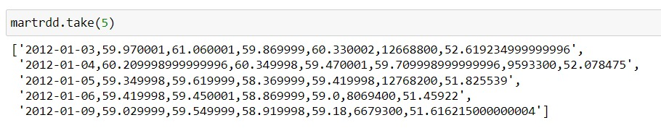
ANALYSIS USING PYSPARK

Slide 16
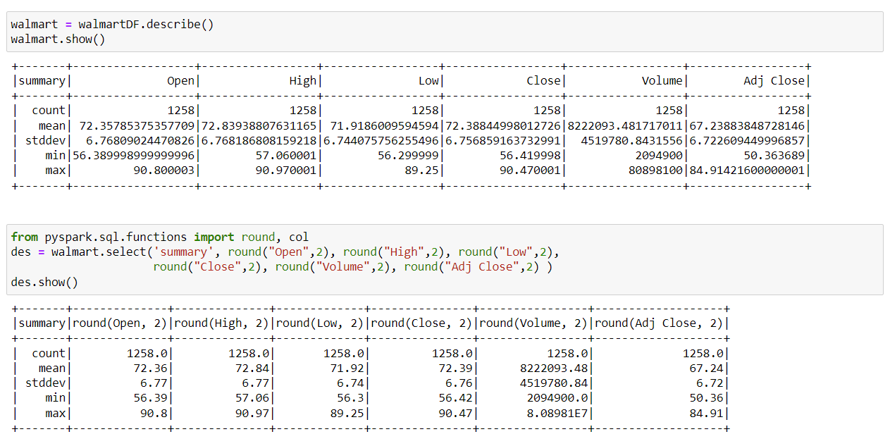
There are too many decimal places for mean and stddev in the describe() dataframe. Format the numbers to just show up to two decimal places.

Slide 17
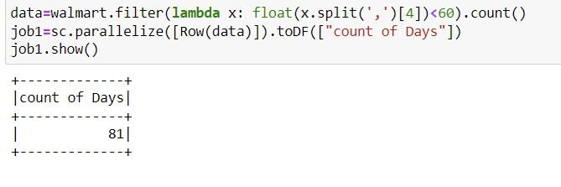
COUNT OF DAYS CLOSE LOWER THAN 60 DOLLARS
When the stock market closes, the last price recorded is the Close price.
81
Days have close price less than 60$.

Slide 18
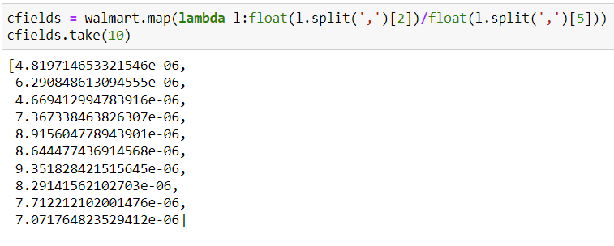
HV RATIO
Ratio of High price versus Volume of stock traded for a day.

Slide 19
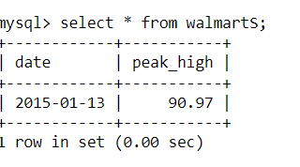
PEAK HIGH IN PRICE
create external table walmart(date string, peak_high float)row format delimited fields terminated by ',' location '/user/hive/warehouse/walmart1/us1.txt’ ;
insert overwrite table walmart select date, max(high) as Peak_High from walmart_stocks group by date order by Peak_High desc limit 1;
On 13th of January 2015, we can observe a peak high price of stocks.

Slide 20
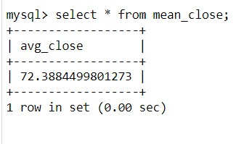
MEAN OF CLOSE
create external table avg_close(close_mean double)row format delimited fields terminated by ',' location '/user/hive/warehouse/walmart1/us2.txt’ ;
insert overwrite table avg_close select avg(Close) as Avg_Close from walmart_stocks;
Mean of close prices of stock

Slide 21
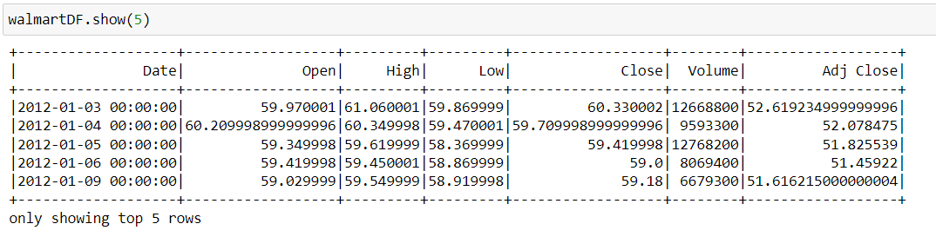
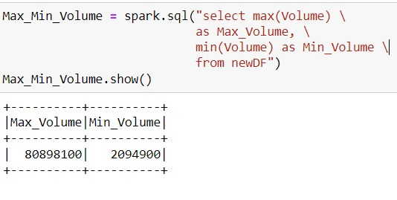
MAXIMUM AND MINIMUM OF VOLUME
walmartDF.createOrReplaceTempView('newDF')
Minimum and maximum of volume of stocks

Slide 22
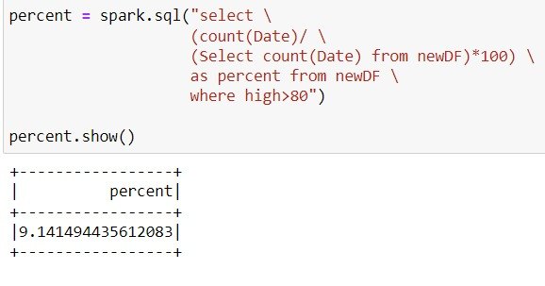
PERCENT OF TIME WAS THE HIGH > 80 $
Percentage of the time when the high prices of stocks were greater than 80$

Slide 23
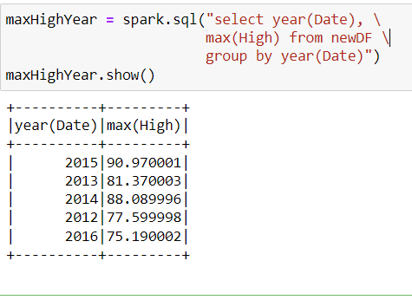
MAXIMUM OF HIGH PER YEAR
Maximum of high prices of stock for each year

Slide 24
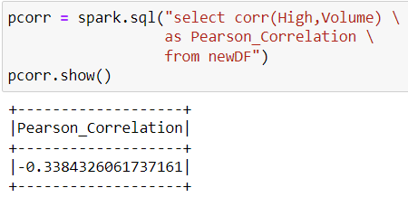
PEARSON CORRELATION
Pearson correlation between high and volume
Pearson correlation is the ratio between the covariance of two variables and product of Standard deviation

Slide 25
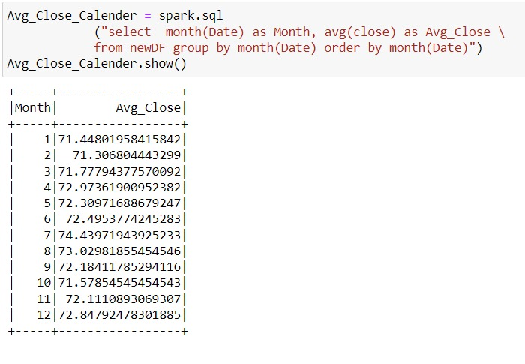
AVERAGE CLOSE FOR EACH CALENDAR MONTH
Average close for each calendar month for two years

Slide 26
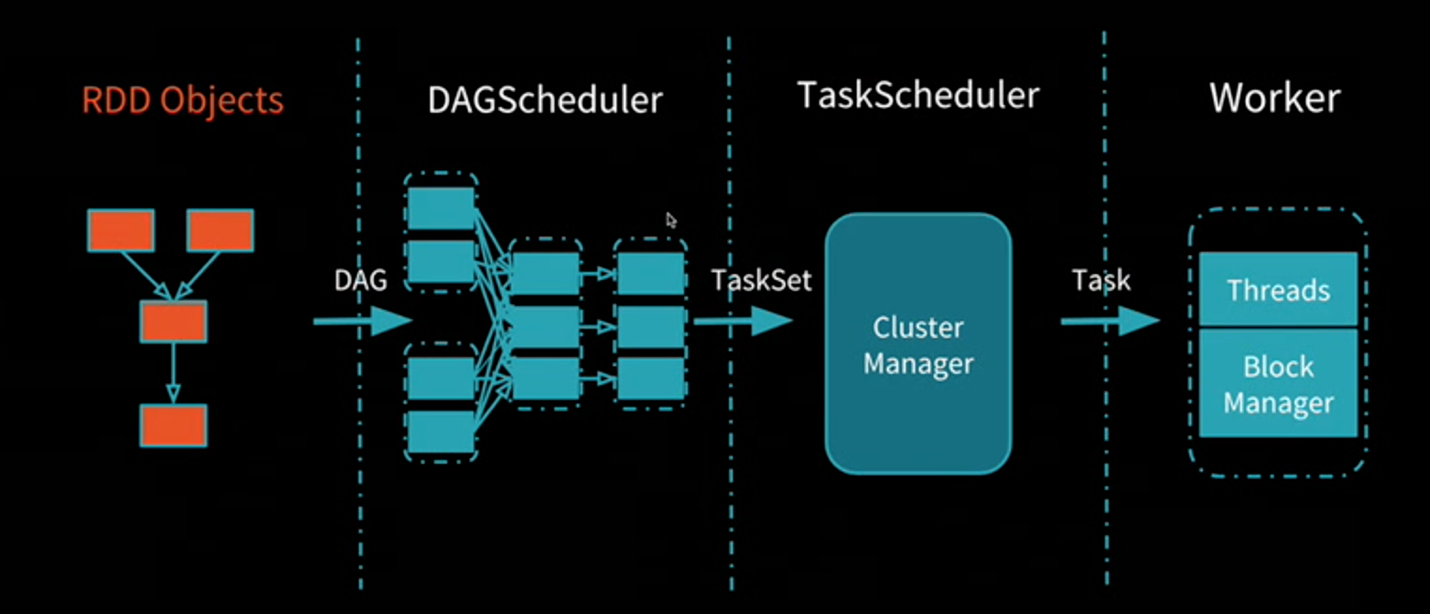
SPARK ARCHITECTURE

Slide 27


THANK YOU

